Slide 1


TRAINING IN INCLUSIVE AND SAFE SHOWDOWN
Funded by the European Union. Views and opinions expressed are however those of the author(s) only and do not necessarily reflect those of the European Union or the European Education and Culture Executive Agency (EACEA). Neither the European Union nor EACEA can be held responsible for them.

Slide 2
SAFETY AND FIRST AID PROVISION IN SHOWDOWN FOR INDIVIDUALS WITH VISUAL IMPAIRMENT
Overview of Showdown Game
Importance of Safety and First Aid
Focus on Accessibility for Individuals with Visual Impairment

Slide 3
UNDERSTANDING VISUAL IMPAIRMENT
Definition and Types of Visual Impairment
Unique Challenges in Gameplay
Importance of Inclusivity in Gaming

Slide 4
SAFETY MEASURES DURING GAMEPLAY
Clear Communication: Use verbal cues to describe the environment and potential hazards.
Designated Safe Zones: Create areas where players can pause and regroup.
Use of Textured Objects: Incorporate tactile elements to help players navigate.

Slide 5
FIRST AID BASICS
Importance of First Aid Training for All Players
Common Injuries in Showdown: Scrapes, bruises, and sprains
Importance of Immediate Response

Slide 6
EMERGENCY PROCEDURES
Identifying Emergency Contacts: Make sure all players know who to contact.
Clear Instructions: Provide step-by-step instructions for calling for help.
Importance of Staying Calm: Encourage players to remain composed during emergencies.

Slide 7
RESOURCES AND SUPPORT
First Aid Kits: Ensure availability at game locations.
Accessibility Tools: Use sound cues, textured markers, and verbal guidance.
Training Sessions: Offer workshops on first aid and safety for all players.

Slide 8

FIRST AID
Part B: Safety in Sports
First Aid Provision involves the immediate techniques applied on-site to an injured or unresponsive individual until emergency medical services arrive. First aid includes monitoring the patient’s vital signs, reviving them, stabilizing their injuries to reduce discomfort, and supporting their recovery.

Slide 9

Part B: Safety in Sports
Why should I learn how to help people in need?
In-hospital heart deaths account for 75% to 80% of all cases.
95% of heart arrest patients die before reaching the hospital.
4'- 6' without a pulse is enough to induce cerebral harm.
The chance of survival increases when CPR is performed.

Slide 10
SOME INDIVIDUALS ARE HESITANT TO MOVE IN AN EMERGENCY.
Part B: Safety in Sports
Anxiety
Guilt
Fear of unsatisfactory performance.
Responsibilities
Fear of disease.

Slide 11
GOOD SAMARITAN LAWS
Part B: Safety in Sports
The Good Samaritan Laws provide legal protection to those people who act, in order to offer help to injured persons. In order to be legally covered you must:
Provide assistance only within the scope of your training.
Request permission before offering help.
Act in good faith.
Avoid using techniques you are not trained in.
Behave sensibly.
Continue monitoring the patient’s vital signs until emergency medical services arrive

Slide 12
EMOTIONAL ASPECTS
Part B: Safety in Sports
Emotional Aspects. Assisting an injured person provides a sense of moral fulfillment. It does, however, elicit other emotions, including dread, anxiety, and remorse.
Having been well-trained, you should not be hesitant to respond.
If necessary, see a doctor
Share your story with others.
Avoid stimulants & alcohol
Relax

Slide 13





THE CHAIN OF SURVIVAL
Part B: Safety in Sports
Early Recognition & Call for Help
Early Cardiopulmonary Resuscitation (CPR)
Early Defibrillation (AED)
Medical Treatment

Slide 14
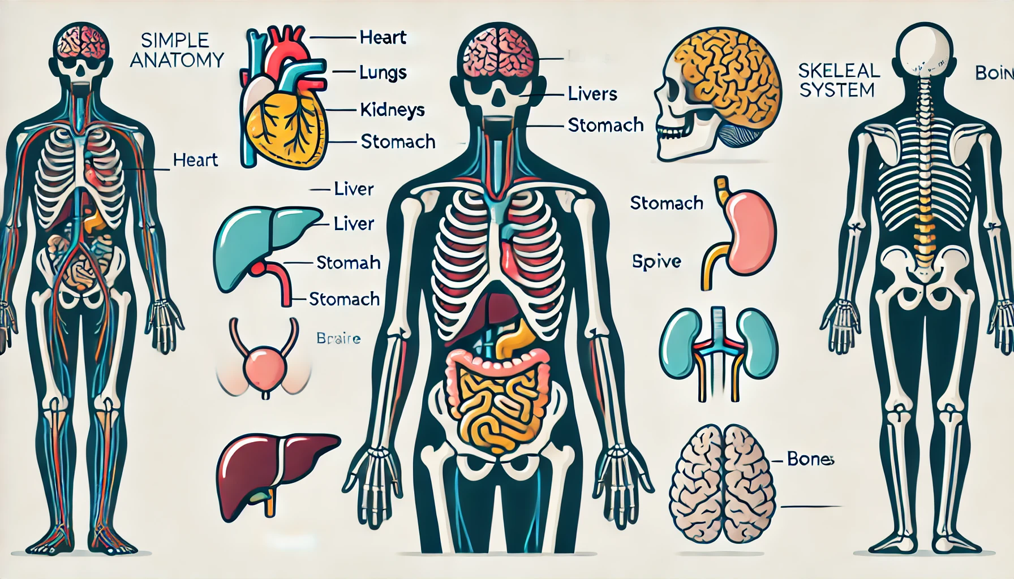
SIMPLE ANATOMY DIAGRAM
Part B: Safety in Sports

Slide 15
A CARDIO-RESPIRATORY DEFICIENT COULD HAPPEN BECAUSE OF...
Part B: Safety in Sports
Heart Attack
Ventricular Fibrillation
Airway Obstruction
Serious Bleeding
Cataplexy (Physical Shock)
Stroke
Immersion Injury
Spinal Injury

Slide 16
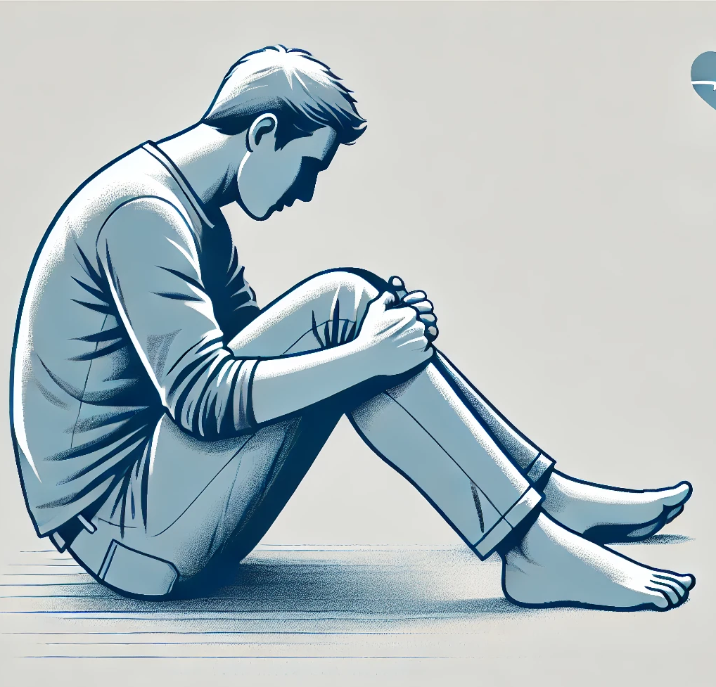
HEART ATTACK
Part B: Safety in Sports
Indications and Symptoms
Chest pain
Pain in the shoulder/ neck/along the arms
Breathing problems
Vomit
Sweat
First Aid
Place the Casualty in ‘W’ Position
Loosen Clothes
Call Emergency Medical Services
Offer Medical Oxygen (if available)
Start CPR if not Breathing

Slide 17
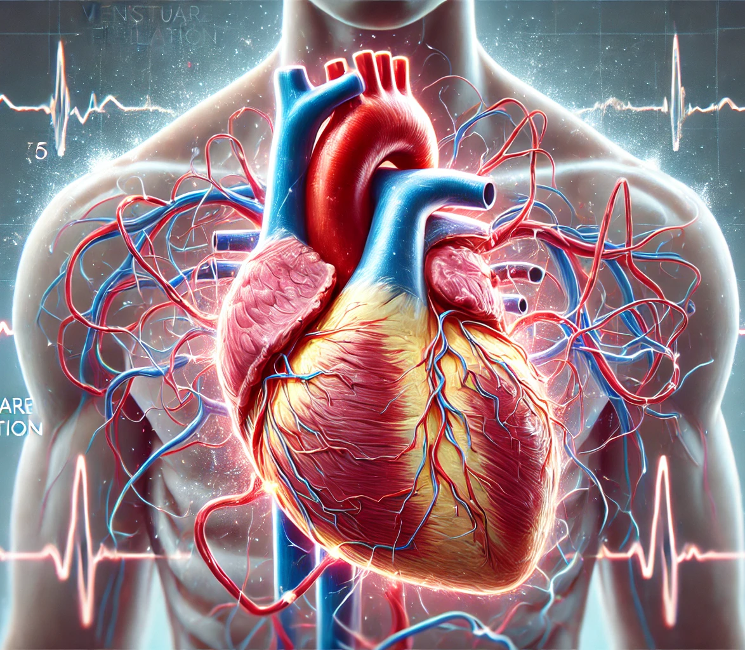
VENTRICULAR FIBRILLATION
Part B: Safety in Sports
Ventricular fibrillation is a situation in which the heart beat rises, resulting in erratic and ineffectual pulses.
Indications and Symptoms
Collapse
Not breathing normally
Not responding
Chest pain on the left side.
Breathing difficulties.
Dizziness.
Pain in the neck and arms, mainly on the left side.
Racing heart beat.
First Aid
Place the victim in ‘W’ position.
Loosen any clothes.
Call the Emergency Medical Services.
Administer Medical Oxygen.
Start CPR if not breathing.
Use an Automated External Defibrillator (AED) if available

Slide 18
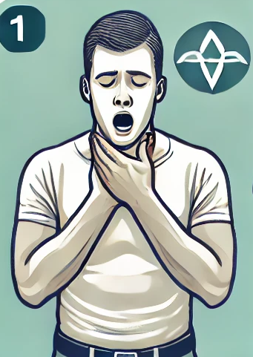
CHOCKING
Part B: Safety in Sports
Airway Obstruction (Chocking) is suffocation induced by a foreign substance blocking the airways.
Indications and Symptoms
Holding the neck
Breathing difficulties
Unable to cough
First Aid
Encourage the patient to cough
Perform back blows
Perform abdominal thrusts

Slide 19

SEVERE BLEEDING
Part B: Safety in Sports
Arterial Bleeding
Bright red blood, spurts out with the rhythm of the heartbeat.
Venous Bleeding
Dark red blood gushes out.
Capillary Bleeding
Blood trickles from a wound.
Direct Pressure
Elevation
Gently Press on central arteries

Slide 20
PHYSICAL SHOCK
Part B: Safety in Sports
Cataplexy refers to a condition where blood flow and drainage from peripheral tissues are inadequate for the body’s functions. It is generally marked by poor peripheral circulation and a drop in blood pressure.
Weak & rapid pulse
Shallow & rapid breathing
Nausea & Vomiting
Pale, bluish skin
Eyes glaze over , bewildered look
Mental confusion, aggression
Thirst
Feeling cold

Slide 21

STROKE
Part B: Safety in Sports
A stroke happens when a blood artery in the patient's brain becomes blocked or ruptures.
Signs & Symptoms
Numbness, paralysis in the arm or leg
Speech difficulties
Side paralysis of the face
Inexplicable headaches
Sudden vision difficulties
First Aid
Loosen clothes
Safe or Recovery Position
Call the EMS
Monitor the lifeline
Administer Oxygen, if available

Slide 22
DROWNING
Part B: Safety in Sports
Drowning is defined as death from suffocation occurring within 24 hours of being submerged in water. Near drowning refers to survival, even if only for a short period, following a submersion incident lasting more than 24 hours. Toddlers often play in and around water, and in emergencies, they are frequently unable to seek help.
Recognition
Waving arms
Head tilted back with the mouth open
Floating face down in the water
Reaction
Recognition
Rescue
Resuscitation

Slide 23
DROWNING – TREATMENT
Part B: Safety in Sports
Check immediately if the casualty is conscious and breathing.
If the individual is conscious, keep them comfortable and monitor their condition.
If they are unconscious but breathing, place them in the recovery position to prevent water intake. Even if they seem to have fully recovered, all drowning victims need medical attention, as they may have inhaled small amounts of water, which can lead to serious respiratory issues for up to 24 hours after the incident.
If the individual is not breathing, start CPR with five initial rescue breaths. Then, continue with the 30:2 compression-to-breath ratio for one minute before calling for help.

Slide 24
SPINAL CORD INJURIES
Part B: Safety in Sports
Spinal injuries, particularly those to the cervical spine, can be very severe because they are frequently associated with vertebrae fractures or dislocations, resulting in significant spinal cord injuries.
Signs & Symptoms
Pins and needles in arms and legs & dizziness
Breathing difficulties
Impaired vision
Reduced mobility
First Aid
Do not move the patient
Stabilize the head & the cervical spine
If needed, turn the victim over carefully

Slide 25

PATHOGENS FOUND IN THE BLOOD
Part B: Safety in Sports
Hepatitis
Hepatitis is an inflammation of the liver , caused primarily by a viruses
HIV/AIDS
Acquired Immunodeficiency Syndrome
Infected blood – Sexual activity
Blood, including vaginal blood
Infected feces
Infected objects
Sperm
Dirty hands
Saliva
Vaginal fluids
Toilet seats
Breast milk
40% Unknown causes
Almost 1/3 of the worlds population is infected.

Slide 26
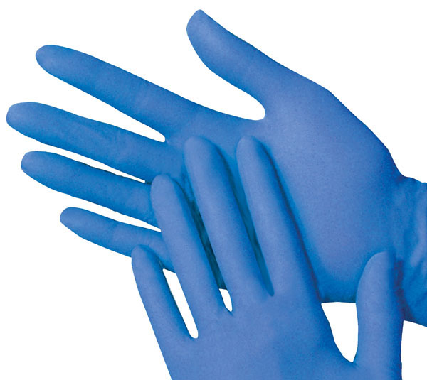
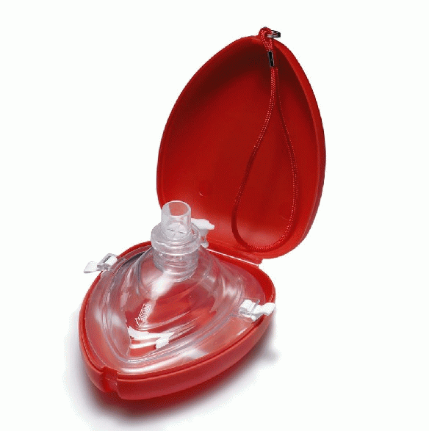
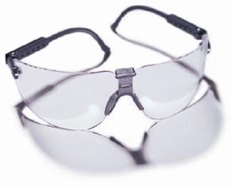

PRODUCTS FOR PROTECTION
Part B: Safety in Sports
Examination gloves.
Use of oronasal resuscitation masks or face shields.
Use of protective goggles.
Use antibacterial products to clean your equipment.

Slide 27
BEFORE YOU ATTEMPT TO HELP, SEEK APPROVAL
Part B: Safety in Sports
•Ask approval before assisting someone who is in peril.
Say, "My name is..........., and I am a first aider." May I assist you?
Begin giving first aid if the patient reacts favorably or if he does not reply at all.

Slide 28
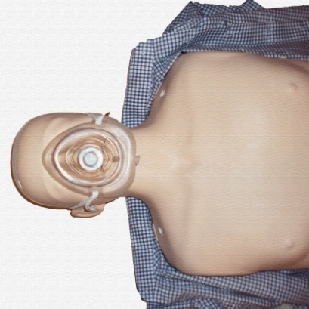
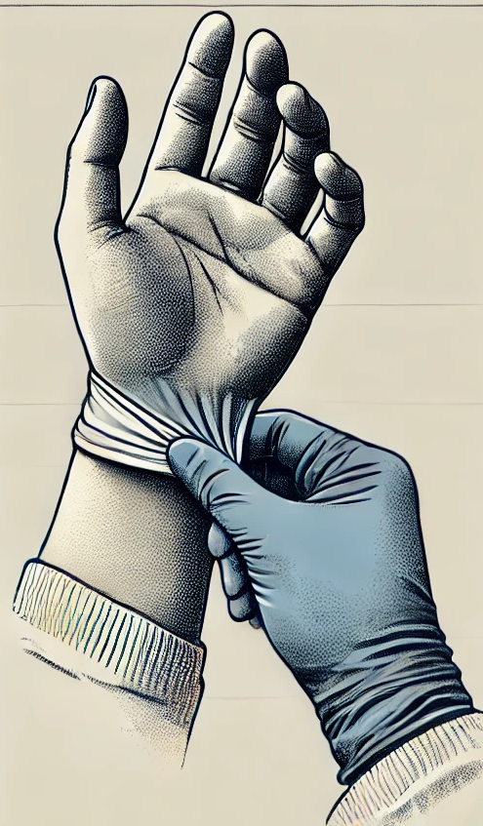
APPLICATION OF BARRIERS
Part B: Safety in Sports

Slide 29
THE ABCDS OF THE LIFE LINE
Part B: Safety in Sports
B = Breathing (Check)
D = Defibrillation
A = Airway Open
Assess Scene
S = Serious Bleeding
Shock
Spinal Injury
C = Circulation

Slide 30
ADULT CPR
Part B: Safety in Sports
The oxygen content of the air we breathe is 21%, with 5% being utilized by our bodies. Adults who are not breathing should receive CPR, using a compression ratio of 30:2 at a rate of 100 to 120 compressions per minute.

Slide 31
PRIMARY SURVEY
Part B: Safety in Sports
Stop
Think
Act
Consider any possible dangers first.
Open Airway.
Check for Breathing
Look – Listen – Feel

Slide 32
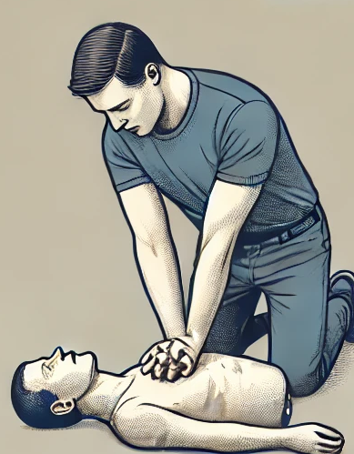
ADULT CPR
Part B: Safety in Sports

Slide 33
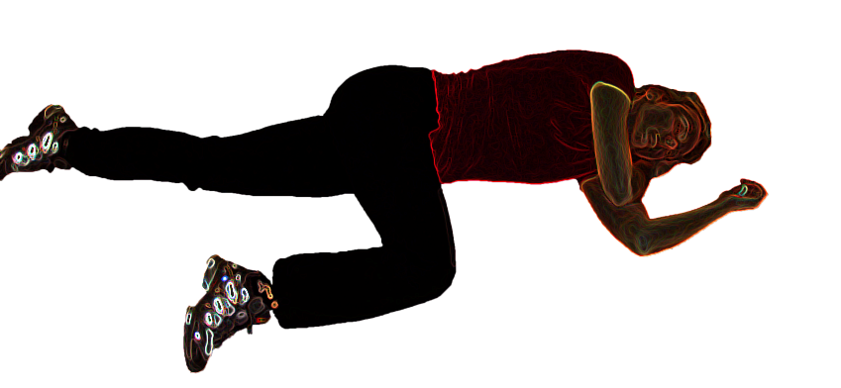
SAFETY POSITION
Part B: Safety in Sports
The casualty has regained consciousness or is breathing regularly but is asleep.
They do not need to be stabilized.

Slide 34
CHOCKING
Part B: Safety in Sports
Encourage them to cough
Perform 5 back blows
5 Abdominal Thrusts
If not breathing, start CPR

Slide 35
SEVERE BLEEDING MANAGEMENT
Part B: Safety in Sports
Follow the safety rescue protocol
Use protective barriers
Apply direct pressure using a bandage or gauze
Elevate the wound
Gently press the main artery of the injured part.

Slide 36
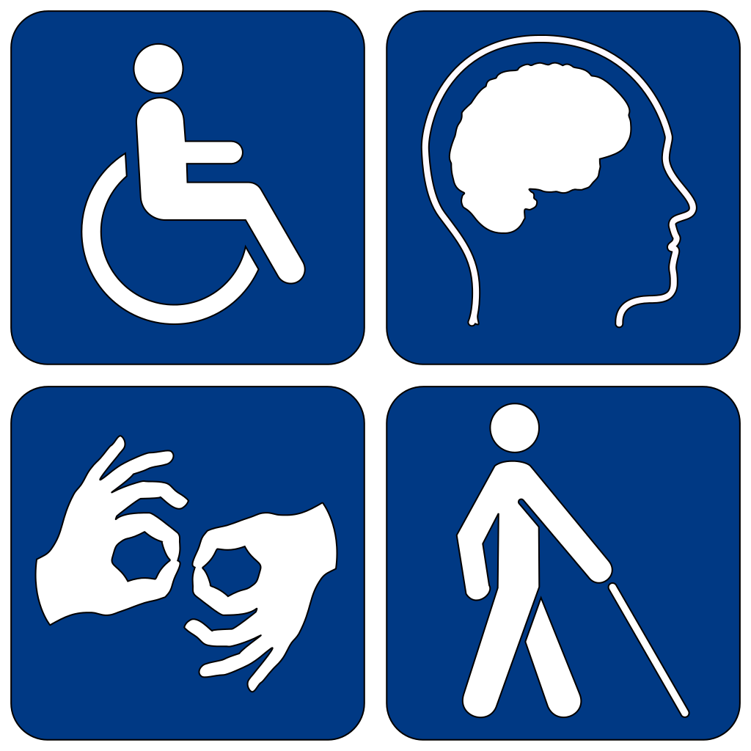
HELPING PEOPLE WITH DISABILITIES
Part B: Safety in Sports

Slide 37
ABOUT DISABILITY
Part B: Safety in Sports
A person with an impairment is described as having a physical or mental condition that severely restricts one or more important living tasks.(Kirschner, K. & Curry, R. 2009)

Slide 38
BASIC INTERACTION WITH PEOPLE WITH DISABILITIES
Part B: Safety in Sports
Use appropriate and polite words.
Make use of person’s first.
Put the person BEFORE the disability
and explain what the person has.

Slide 39
VISION IMPAIRMENT
Part B: Safety in Sports
People with low vision have restricted eyesight.
Please identify yourself as well as all guests.
Offer to use your arm and walk normally to refer folks.
Use your usual speech. Notify the individual when you are leaving.

Slide 40
DEAF OR HARD OF HEARING
Part B: Safety in Sports
Hearing loss can vary in intensity from mild to serious.
People with hearing loss may use a variety of methods and instruments, such as sign language translators, making notes, lipreading, or speaking.
Tap them on the shoulder or elbow to get their focus.
When using with close eye contact
Natural movements and face reactions

Slide 41
MENTAL HEALTH CONDITIONS
Part B: Safety in Sports
Mental disease is a catch-all word for a variety of illnesses affecting the psyche and brain.
Bipolar disorder, melancholy, schizophrenia, anxiety, and personality illnesses all have an impact on how people think, feel, and conduct.
People suffering from mental illnesses may have difficulty focusing, which could be a side effect of the medications.
To keep their condition from worsening, try to avoid excessively tense circumstances as much as possible.
hidden
Stress can impair a person's performance
They have distinct characteristics
Do not presume they are violent
Possess sound reasoning

Slide 42
INTELLECTUAL DISABILITY
Part B: Safety in Sports
People with cerebral impairments may experience substantial restrictions in the skills required to live and work in the workplace, such as speech, self-care, social skills, safety, and self-determination.
Use short, straightforward words.
Please be patient.
Avoid using infantile language.

Slide 43
PHYSICAL DISABILITY
Part B: Safety in Sports
Disability is generally defined as the limitation of one or more of a person's physical processes, most commonly movement, agility, or stamina.
People with bodily impairments are often specialists in their own requirements and are aware of the consequences of their condition.
Place your seat at eye level.
Do not shove, rely on, or grab someone's wheelchair.

Slide 44
PEOPLE WITH ACQUIRED BRAIN INJURY
Part B: Safety in Sports
Any form of brain damage that happens after delivery is referred to as acquired brain injury (ABI). Infection, sickness, a lack of air, or brain injuries can all result in injury.

Slide 45
AUTISM SPECTRUM DISORDER
Part B: Safety in Sports
Autism is a broad word that encompasses autism, Asperger's disease, and unusual autism.
Autism alters how knowledge is processed and retained in the brain.
Autistic people usually struggle with vocal and nonverbal speech, social engagement, and other tasks.

Slide 46
HELPING PEOPLE WITH DISABILITIES (IF RESPONSIVE)
Part B: Safety in Sports
Vision
We tell the individual where he or she is in the region.
We describe the trauma
Hearing
To aid lip reading, we talk slowly and evenly.
Use sign language if possible
Intellectual
We give simple instructions explaining the situation and we always wait for understanding
Motor
We explain the situation as it is and promote active cooperation
Mental
Be supportive and explain what and how will we provide first aid as many times is needed.
In some cases distraction may help

Slide 47
AUTOMATIC EXTERNAL DEFIBRILLATOR (AED)
Part B: Safety in Sports

Slide 48
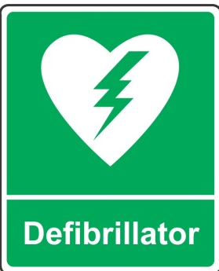
Part B: Safety in Sports
C.P.R. – A.E.D.

Slide 49
THE AUTOMATED EXTERNAL DEFIBRILLATOR (A.E.D.)
Part B: Safety in Sports
An A.E.D. is the only successful treatment for atrial arrhythmia.
Age > 8 years
Use an adult AED and any recognized adult first aid technique.
Age 1 - 8 years
Use paediatric pads. They reduce the power delivered to a lower and safer level.

Slide 50
THE AUTOMATED EXTERNAL DEFIBRILLATOR (A.E.D.)
Part B: Safety in Sports
A battery-powered novel technology gadget.
It is built on a microcontroller and includes an automatic analysis system to detect the presence of a heartbeat.
It is linked to the subject via two sensors.
There are requirements in some areas before using an A.E.D.
If an AED is accessible, do not delay to use it.
( Perform CPR and defibrillate the victim for 2 min)

Slide 51
ACTIVATE THE A.E.D. & ATTACH THE PADS
Part B: Safety in Sports
Activate the A.E.D. & attach the pads
Some A.E.Ds will turn on immediately when the cover is opened. Others may require you to hit the ON switch. If required, connect lines to the A.E.D.
Remove any exterior packaging from the cushions.
Examine the directions on the cushions closely.
Remove any covering paper and adhere the patches to the casualty's torso as shown.
One cushion should be positioned beneath the right collarbone, next to the breastbone.
The other cushion should be placed on the edge of the breast wall below the left shoulder.

Slide 52
ANALYZE
Part B: Safety in Sports
Following effective pad connection, the A.E.D. will evaluate the heart rate. The gadget will determine whether or not electrocution is recommended.
Maintain your distance during the investigation.
Make certain that no one contacts the victim while the A.E.D. is studying the cardiac beat, as this may result in incorrect findings.
Pay attention to the audio instructions.

Slide 53
NO SHOCK INDICATED
Part B: Safety in Sports
If the speaker tells you to begin CPR, begin chest compressions and emergency respiration right away.
Continue CPR for two minutes, or until instructed to cease.
Continue to listen to the audio instructions.

Slide 54
SHOCK INDICATED
Part B: Safety in Sports
Ascertain that everyone is free of the victim.
As instructed, press the jolt switch.
Continue CPR for two minutes after the jolt is given, or until instructed to cease.
Allow the AED to perform its analysis.
Continue to listen to the audio instructions.

Slide 55
AED SAFETY
Part B: Safety in Sports
AED is like any other electrical appliance in that certain safety precautions should be observed to minimize the risk of injury to the operator, assistants or even the casualty.
Keep the electrodes (pads) separate.
Never connect the pads to anyone except a casualty in suspected cardiac arrest.
Be aware of patches on skin.
Be aware of implants.
Be aware of inflammable environments.

Slide 56
AED STORAGE
Part B: Safety in Sports
AED should be stored in a secure but easily accessible location. Storage should be clean and dry
The AED's position should be plainly marked with the recognized worldwide symbol.
Other things that could be stored with the AED include:
Battery backup
Paediatric diapers and other spare cushions
Razor for breast preserving
Tough Cuts for Clothes Opening Towel for Wiping the Chest Gloves

Slide 57
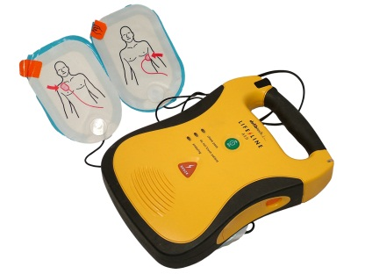
DEFIBRILLATION
Part B: Safety in Sports
Any exercise should only be carried out on teaching dummies.

Slide 58
CPR - DEFIBRILLATION
Part B: Safety in Sports
Any exercise should only be carried out on teaching dummies.

