Slide 1


TRAINING IN INCLUSIVE AND SAFE SHOWDOWN Part A - Inclusiveness
Funded by the European Union. Views and opinions expressed are however those of the author(s) only and do not necessarily reflect those of the European Union or the European Education and Culture Executive Agency (EACEA). Neither the European Union nor EACEA can be held responsible for them.

Slide 2
TRAINING IN INCLUSIVE AND SAFE SHOWDOWN
Part A: Inclusive SHOWDOWN
Part B: First Aid and Safety in Sports

Slide 3
INTRODUCTION TO SHOWDOWN
Showdown is a sport specifically designed for the blind and visually impaired.
It combines elements of air hockey and table tennis.
Developed in the 1960s by Joe Lewis, a blind Canadian.
People with and without visual impairments can compete equally.

Slide 4

PROMO VIDEO OF SHOWDOWN
https://www.youtube.com/watch?v=--dc1dbmy98

Slide 5
EVOLUTION AND GROWTH OF THE SPORT GLOBALLY
Initially played in small communities and schools for the blind.
Over the decades, the sport has evolved and gained popularity worldwide.
Adoption of standardized rules and equipment.
Formation of national and international organizations to promote and regulate the sport.
Not yet a paralympic sport but international championships are organized by IBSA.

Slide 6
INTRODUCTION TO SHOWDOWN
Showdown is a sport specifically designed for the blind and visually impaired.
It combines elements of air hockey and table tennis.
Developed in the 1960s by Joe Lewis, a blind Canadian.
People with and without visual impairments can compete equally.

Slide 7
EQUIPEMENT
Specially designed table with goal pockets at each end.
Paddle for each player.
Audible ball with a bell inside to assist players in tracking its movement.
Gloves
Masks

Slide 8
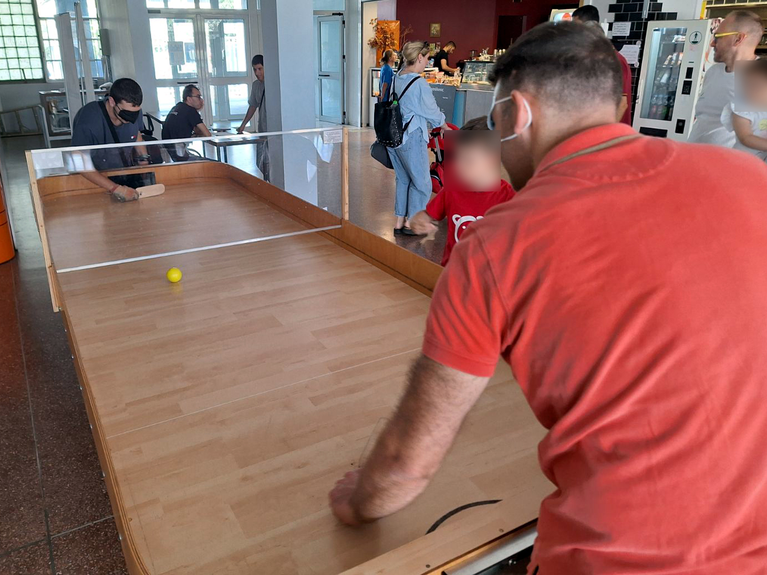
EQUIPEMENT

Slide 9
OBJECTIVE, PLAYERS, GAMEPLAY
The main objective is to score goals by hitting the ball into the opponent's goal pocket using a paddle.
Two players compete against each other.
The game begins with a serve, alternating between players.
Players must keep one hand on the table at all times.
Points are scored when the ball enters the opponent's goal pocket or when the opponent make a fault.

Slide 10
SCORING
Players score points by hitting the ball into the opponent's goal pocket. A goal is worth 2 points.
The serve must be made within 2 seconds of the referee's whistle. The ball must bounce off the sidewall once before passing under the centerboard. If the serve is irregular (e.g., multiple touches, early serve), the opponent receives 1 point.
The ball must pass under the centerboard, not over it. If the ball hits the centerboard and stops, the opponent receives 1 point.

Slide 11
SCORING
Players must only touch the ball with the bat or batting hand. If the ball touches any other part of the body, the opponent receives 1 point.
Players cannot use their bat or batting hand to block the ball within the goal area. If this happens, the opponent receives 1 point. If the ball then goes into the goal, the opponent receives 2.
If the ball is hit out of the playing area, the opponent receives 1 point.

Slide 12
WINNER
Matches are played best of 1 or 3 or 5 sets.
The winner of the match is the player who:
wins 1 set, in 1 set matches.
wins 2 sets, in 3 sets matches.
wins 3 sets, in 5 sets matches.
The winner of the set is the player to reach a minimum of eleven (11) points having a margin of two points (2) over the opponent.

Slide 13
INCLUSIVENESS
The rules of Showdown are very strict to ensure fairness and inclusivity in the sport. A key aspect of this inclusivity is the requirement for all players, whether they have visual impairments or not, to wear eye coverings. This ensures that everyone competes on an equal playing field, making the sport accessible and enjoyable for all participants.

Slide 14
IBSA RULES
For the official rules of IBSA please visit the site
https://ibsasport.org/sports/showdown/rules-and-downloads/

Slide 15
VIDEOS
European Final 2022
https://www.youtube.com/watch?v=GC-K-W39IZg&list=PLCbr7zOM2Wf_QirpPzWpXGbT5vCHX3O0-&index=12
World Cahmpionship 2019
https://www.youtube.com/watch?v=IXjullfUf4A&list=PLsmqPJvqms93F596k2rWL0rkECSnayxfv&index=6

Slide 16
LET’S PLAY !!!

